Slide 1





MAMC01901 Business Analysis
Week 4 (Session 2): Business analysis techniques (Root cause analysis)

Slide 2



Agenda
Root cause analysis
Class activity
Assessment 2

Slide 3
Root Cause Analysis
What is root cause analysis?
RCA is a method used to identify the underlying reasons for a problem or defect.
Goal: To find the true causes of the problem or defect.
When to Use: Recurring problems, quality issues, or incidents requiring corrective action.

Slide 4
Root Cause Analysis
RCA Process
Define the problem
Gather data to identify possible causal factors
Determine possible root causes
Recommend and implement solutions

Slide 5
Fish Bone Diagram
Visual tool to systematically explore potential causes of a problem.
Often uses the 6 Ms:
M | What It Represents
Man (People) | Human-related factors, cultural behaviours, training gaps
Machine | Equipment or technology used
Method | Processes and procedures
Material | Physical inputs or components
Measurement | Data collection, analysis, tracking and metrics
Mother Nature (Environment) | Environmental and external factors

Slide 6
Fish Bone Diagram
Example: Delayed Customer Orders
Rebel sports has recently been experiencing consistent delays in fulfilling customer orders typically by 3 to 5 days. Several issues across the order and shipping process seem to be contributing to the delays. For instance, some staff members are unfamiliar with the new order processing system, leading to mistakes and slowdowns. There have also been recurring problems with the printer used for generating shipping labels, which frequently jams and causes delays in packaging. The order entry process itself is still done manually, making it slow and prone to errors. Additionally, the packaging supplies, such as boxes and tape, often run out unexpectedly because inventory levels are not properly tracked. On top of that, there is no effective system in place to track how long it takes to pack and dispatch each order, making it hard to spot bottlenecks. Lastly, external factors like bad weather have been affecting delivery trucks and causing further delays.

Slide 7
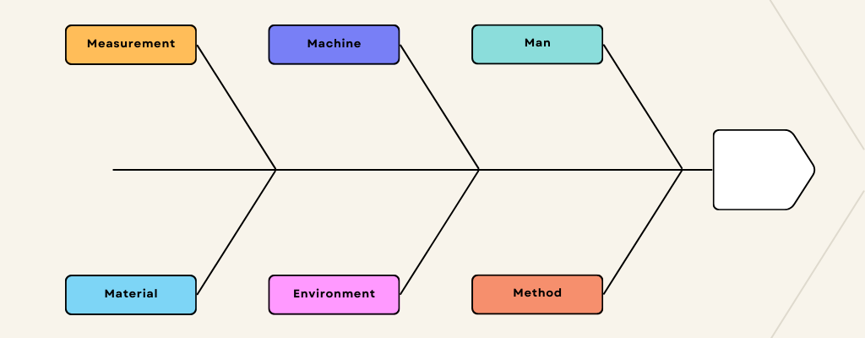
Fish Bone Diagram
- No effective performance metrics for packing or dispatch
No tracking of inventory
Frequent printer jams causing delays
Staff members unfamiliar with new system
Delayed customer orders by 3-5 days
Packing supplies running out of stock
Manual order entry is slow and error prone
Bad weather effecting delivery

Slide 8
5 Whys
Developed by Sakichi Toyoda, founder of Toyota Industries.
Ask “Why?” five times (or more) until the underlying cause is found.
Useful for identifying process and system failures.

Slide 9
5 Whys
Example: Titanic
Problem: Titanic sank on April 15, 1912, resulting in the loss of over 1,500 lives.
Why? Because it struck an iceberg in the North Atlantic Ocean.
Why? Because the lookout crew spotted the iceberg too late to avoid a collision.
Why? Because the ship was travelling at high speed through icy waters, and the lookouts had no binoculars.
Why? Because there was pressure to arrive early and showcase the ship’s speed and luxury, and key safety equipment was overlooked.
Why? Because of overconfidence, competition with rival shipping lines
Root cause: A culture of overconfidence, poor risk management, and a desire for prestige led to unsafe decisions, ultimately causing the disaster.

Slide 10
Class Activity
Read the Toyota case study (in Teams under Class Activities).
Identify the main issue that Toyota faced from the case study.
Use the Fishbone Diagram to evaluate the issue.
Perform a 5 why’s analysis to identify the root cause of the problem.
Based on your analysis, suggest 2 to 3 realistic solutions Toyota could implement to address the issue.
For each solution, briefly explain why it would help solve the problem.
.

Slide 11
Assessment 2
Critically evaluate the role of a business analyst in the chosen organisation.
Critically analyse at least two contemporary organisational issues that the organisation may face or is currently facing.
Critically apply at least two business analysis techniques to evaluate the issues faced by the organisation.
Propose and critically justify the alignment of solutions to the issues with the organisation’s strategic goals.
.

Slide 12
Assessment 2
Critically evaluate the role of a business analyst in the chosen organisation.
Needs to be more detailed compared to 1st assessment. Mention in good detail what is the role of the business analyst in the organisation, what are their activities, how does the BA add value.
Critically analyse at least two contemporary organisational issues that the organisation may face or is currently facing.
Identify 2 organisational issues discuss the issues in detail. Think about how you can use either SWOT analysis or fishbone diagram or 5 why’s to evaluate those issues.
.

